Slide 1
EMPLOYEE DATA ANALYSIS USING EXCEL
STUDENT NAME : BHALASARASWATHI S.P
REGISTER NO : 312209187
DEPARTMENT : B.COM BANK MANAGEMENT
COLLEGE : ANNA ADARSH COLLEGE FOR WOMEN

Slide 2
PROJECT TITLE
Employee Performance Analysis using Excel

Slide 3


AGENDA
Problem Statement
Project Overview
End Users
Our Solution and Proposition
Dataset Description
Modelling Approach
Results and Discussion
Conclusion

Slide 4

PROBLEM STATEMENT
Conducting an Employee Performance Analysis using Excel helps students like me to develop essential Excel and data analysis skills, while providing insight into key performance metrics and HR analytics. It allows me to apply theoretical knowledge to practical scenarios, enhancing my problem-solving and critical thinking abilities. The project also helps to strengthen my ability to organize and present data effectively. Ultimately, this experience prepares me for careers in data-driven roles and boosts my employability by showcasing my analytical capabilities.

Slide 5

PROJECT OVERVIEW The Employee Performance Analysis using Excel project involves analyzing employee data to assess key performance indicators such as productivity, efficiency, and contribution to the organization. Students like me use Excel to organize and analyze this data through formulas, pivot tables, and charts, identifying trends, patterns, and areas needing improvement. The project also includes creating visual reports and dashboards to present the findings clearly. This hands-on experience helps me to develop data analysis, problem-solving, and presentation skills, preparing me for roles in HR analytics, business management, and related fields.

Slide 6

WHO ARE THE END USERS?
The End Users Of Employee Data Analysis Typically Include:
Human Resource Professionals
Managers And Team Leaders
Executives And Senior Management
Employees and Employers
Data Analysts
Industries
IT Sector
Business Units

Slide 7

OUR SOLUTION AND ITS VALUE PROPOSITION CONDITIONAL FORMATING : It Is Used To Highlight The Bank Values In Exit Date. FILTER : It Is Used To Filter The Bank Values By Using Filter By Using Colors PIVOT TABLE : Pivot Tables In Excel Are Used To Summarize, Analyze, And Explore Large Datasets By Automatically Organizing Data Into A Structured Format. CHARTS : It Is Used To Show The Analysis In A Proper Chart Format.

Slide 8
DATASET DESCRIPTION Employee ID : Unique identifier for each employee in the organization. Described in numbers First name : First name of the employee in text Last name : Last name of the employee in text Business unit : The specific business unit or department to which the employee belongs, in text. Employee status : The current employment status of the employee i.e. active, on leave, terminated. Employee type : The type of employment the employee has full-time, part-time, contract. Gender code : A code representing the gender of the employee, M for male, F for female, N for non-binary. Performance score : A score indicating the employee’s performance level i.e. excellent, satisfactory, needs improvement. Current employee rating : The current rating or evaluation of the employee’s overall performance.

Slide 9

THE "WOW" IN OUR SOLUTION FORMULA USED FOR FINDING THE PERFORMANCE LEVEL OF EMPLOYEES =IFS(Z8>=5,"VERY HIGH",Z8>=4,"HIGH",Z8>=3,"MED",TRUE,"LOW")
3/21/2024 Annual Review
9

Slide 10
MODELLING
DATA COLLECTION :
Downloaded the dataset from edunet dashboard
Opened the data in excel
Saved the file in desktop as an(.xls) file
FEATURE COLLECTION :
Used conditional formatting
Used fill color option
Used filter option to separate blanks in the column
DATA CLEANING :
Filtering the data according to our needs
Making the data into a structured data
Separating the important columns
10

Slide 11
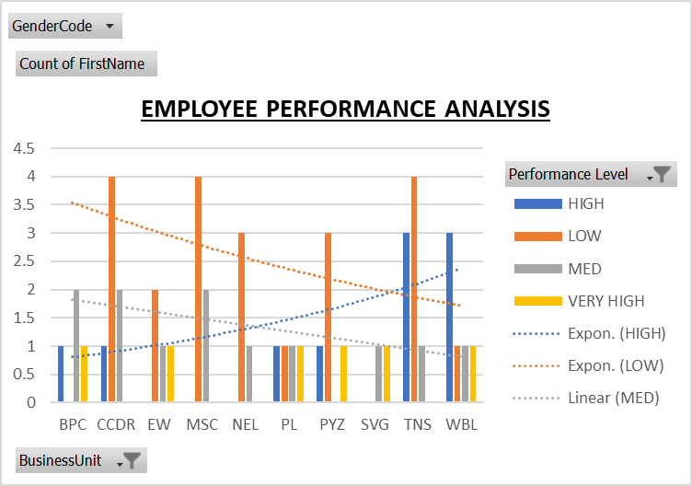
RESULTS
11

Slide 12
CONCLUSION
In conclusion, Employee Performance Analysis is a crucial process that enables organizations to assess and improve their workforce’s effectiveness. By systematically evaluating various performance metrics, companies can identify top performers, address areas needing improvement, and make informed decisions about promotions, training, and resource allocation. This analysis not only helps in enhancing productivity and employee satisfaction but also aligns individual performance with organizational goals, ultimately driving business success. Utilizing tools like Excel for this analysis further streamlines the process, making it more efficient and accessible for organizations of all sizes.

